Slide 1


INSTITUTE FOR ADVANCED COMPUTING AND SOFTWARE DEVELOPMENT AKURDI, PUNE
Project Review on
Online Railway Reservation System
Guided By
Mrs.Vaishali Chikhalkar
Mr. Kashinath Patil
Project By
Group No. 31
Bhushan Amrutkar 210941220047
Shubham Patidar 210941220187

Slide 2
Contents
Introduction
Objective
Technology Used
Use case Diagram
Database
Project website snapshot
Advantages
Future scope
Conclusion

Slide 3
Introduction
This system basically concerned with reservation and cancellation of railway tickets to the passenger .
The need of this system because as is the known fact that India has the largest railways network in the whole world and it is difficult to handle such large system manually .
By computerizing it ,it become possible to overcome the limitation and make the system operations more efficient.

Slide 4
The complexity in handling data and records of such a vast system got reduced and become easier by computerizing the system being more specific , this online railway reservation can perform basic operation like reservation and cancellation .
The users are required to register on the application to book the ticket.

Slide 5
Objectives
The main objective of Railway reservation system to manage the detail of the Train , Booking , Seat , Payment, Ticket, It manage all the information about the Train, Customer , Ticket.
The Purpose of the project is to build an application program to reduce manual work for managing Train , Booking ,Payment ,Ticket and tracks all the details.

Slide 6
Easy operations for the operator of the system. User interfaces are user accommodating and attractive; it takes very less time for the operator to use the system.
The aim is to design a online of Railway reservation system which is booking ticket in online mode .
Simple database is maintained.

Slide 7
Technology Used:
Front End : React Js
Back End : Java Spring Boot API
and MySQL

Slide 8
Software Used:
STS ide
Java JDK 1.8
Inbuild tomcat server
VS Code

Slide 9
Why this Technologies :
Why Spring Boot
Why React JS
Easy to create rest web services
We can use spring starter to build project
We can reduce boiler plate code for faster development .
Spring Boot JPA is a Java specification for managing relational data.
opensource and large community
React used to build fronted UI.
We can build single page application
Faster page load speed.

Slide 10
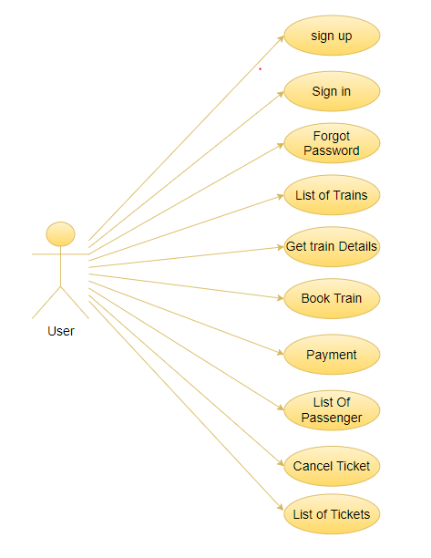
Use case diagram for User :

Slide 11
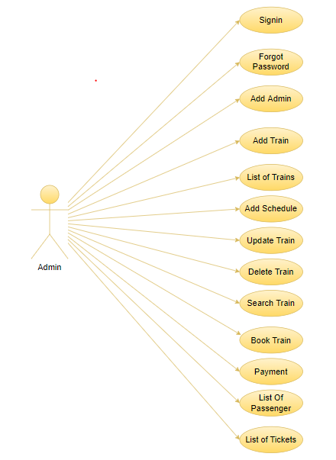
Use case diagram for Admin :

Slide 12
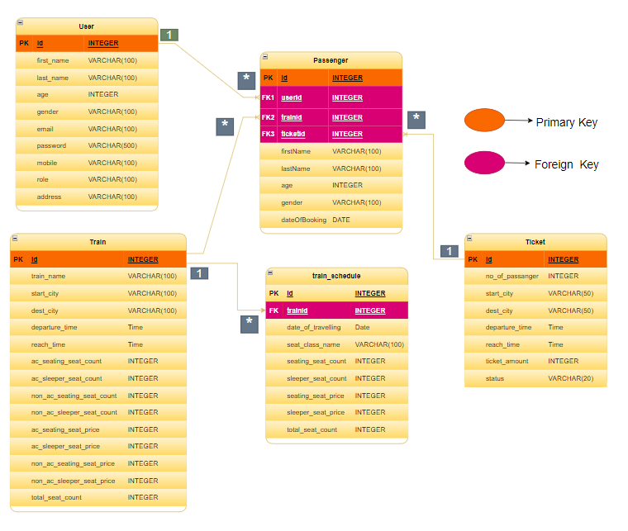
Database

Slide 13
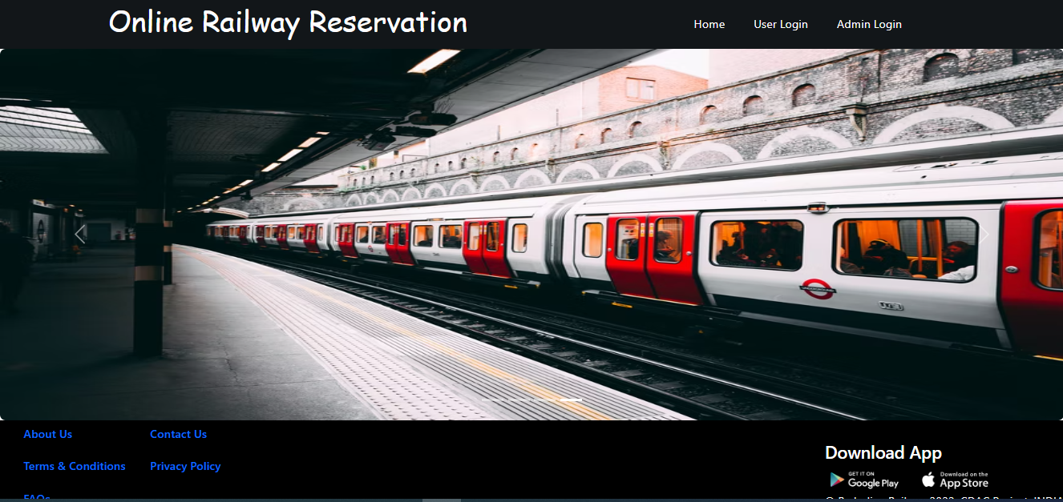
Home page

Slide 14
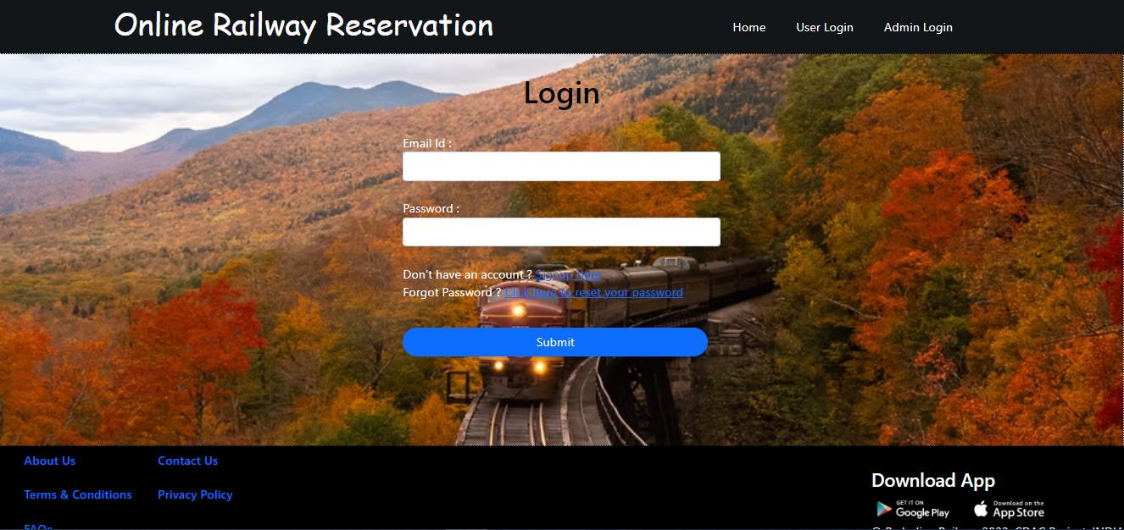
Login Page

Slide 15
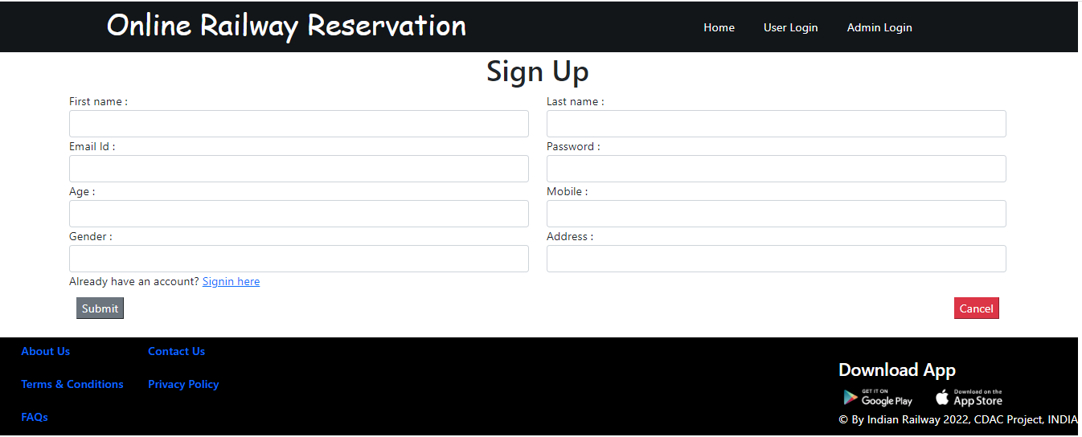
SignUp Page:

Slide 16
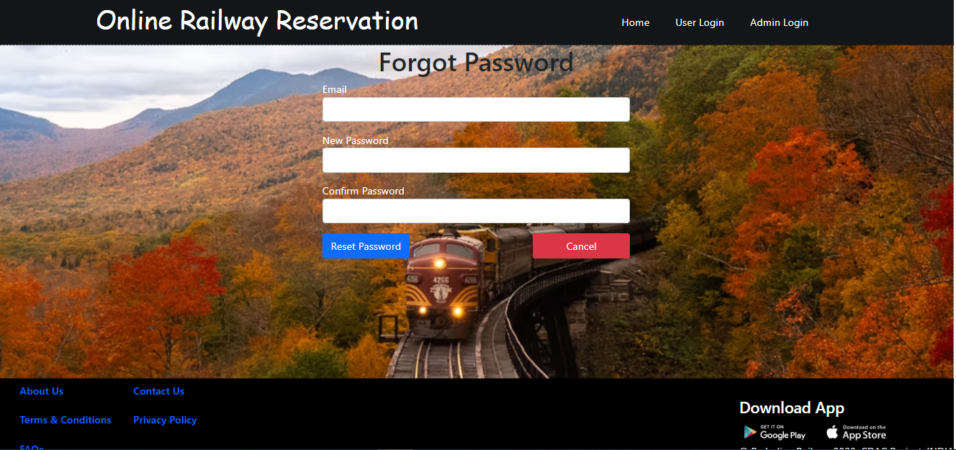
Forgot Password:

Slide 17
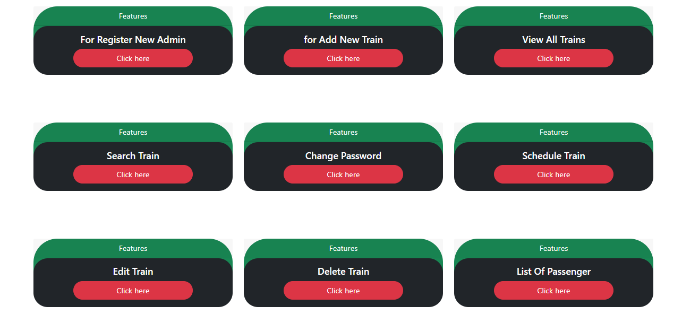
Admin DashBoard

Slide 18
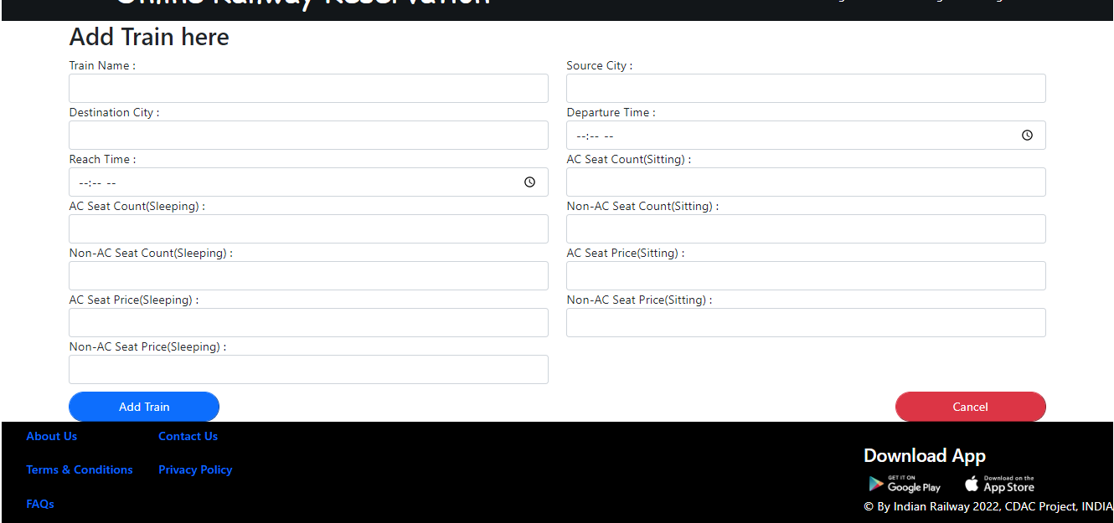
Admin can Add Train

Slide 19
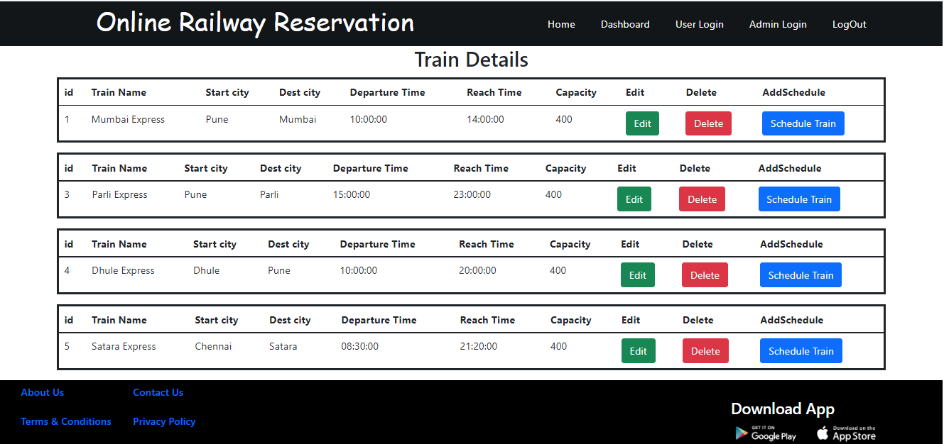
Train Details Page

Slide 20
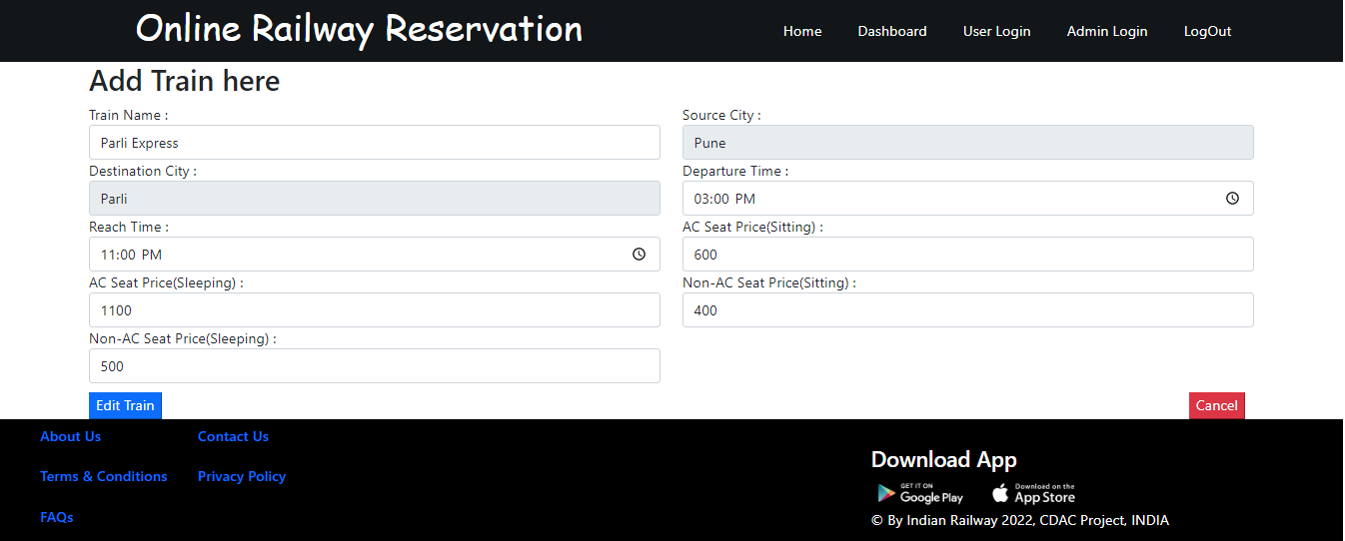
Update Train :

Slide 21
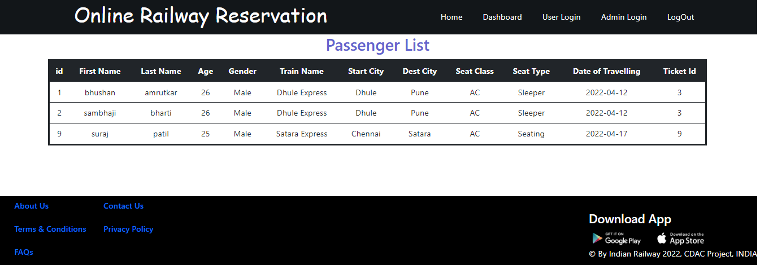
List of Passenger Page

Slide 22
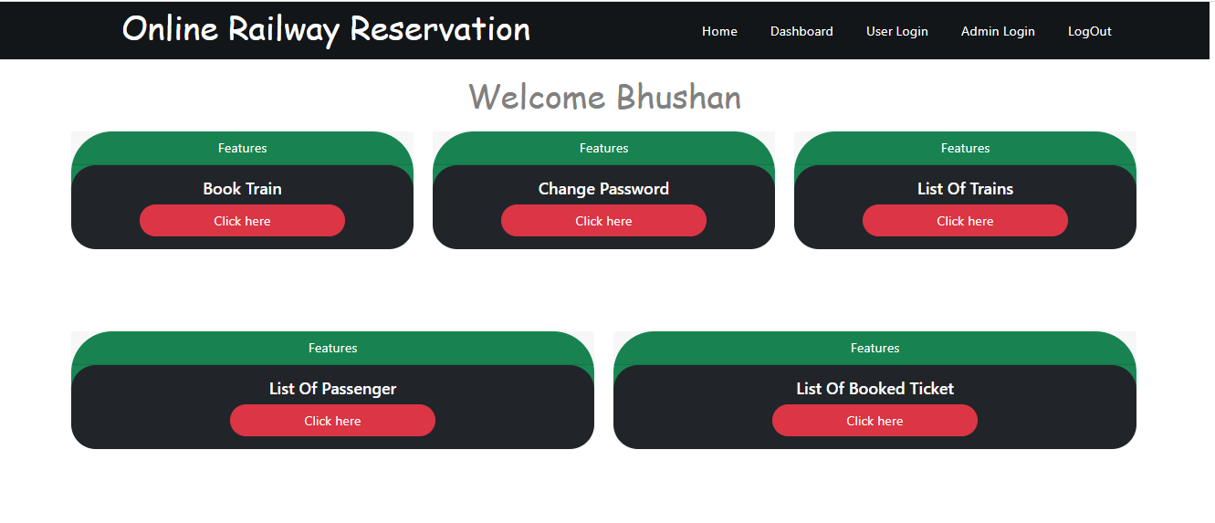
User Dashboard Page

Slide 23
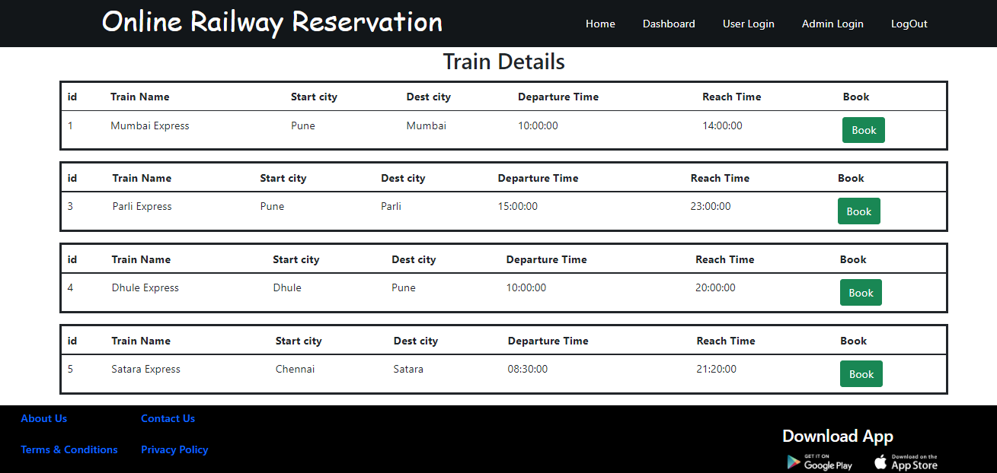
List Of Trains :

Slide 24
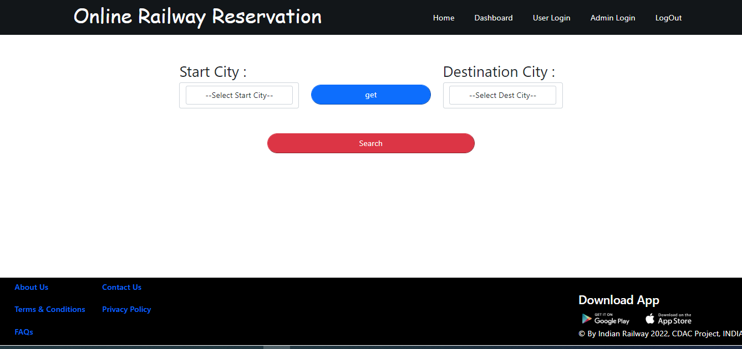
Search train Page :

Slide 25
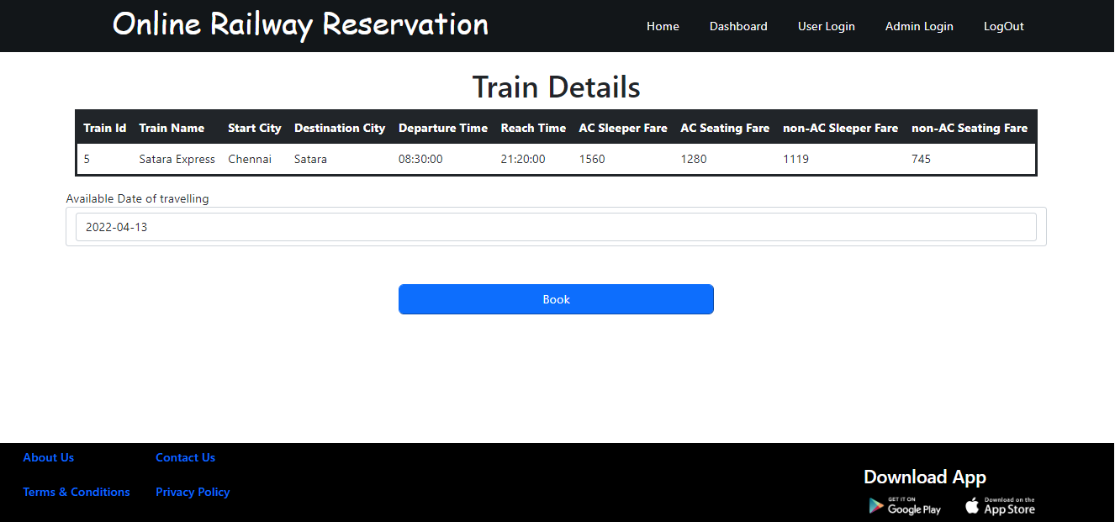
Train Details Page :

Slide 26
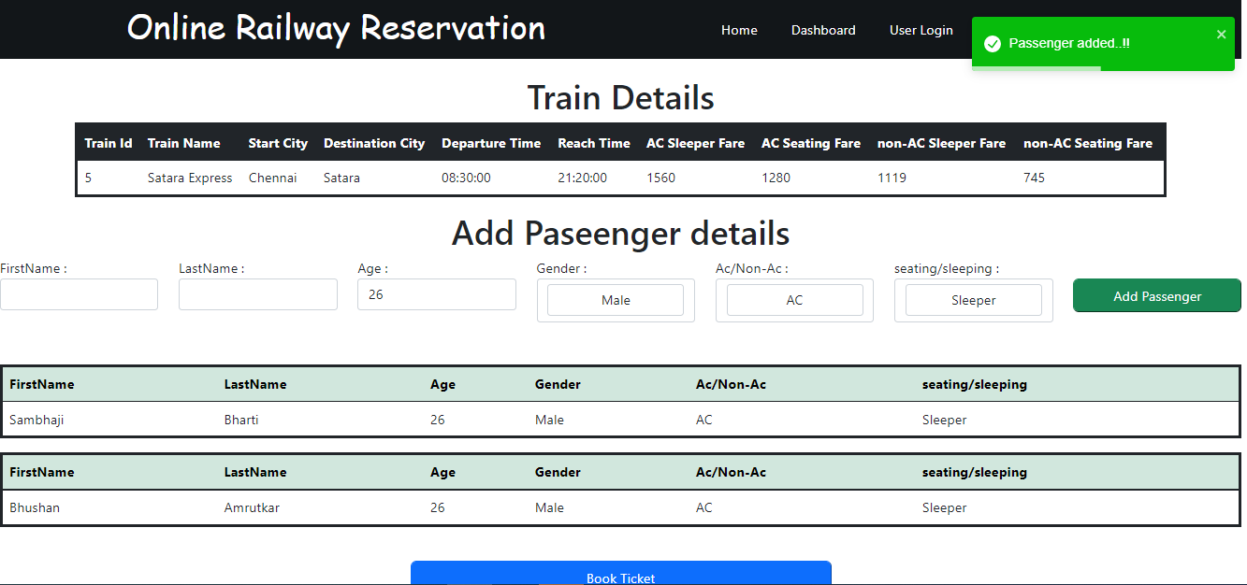
Add Passenger :

Slide 27
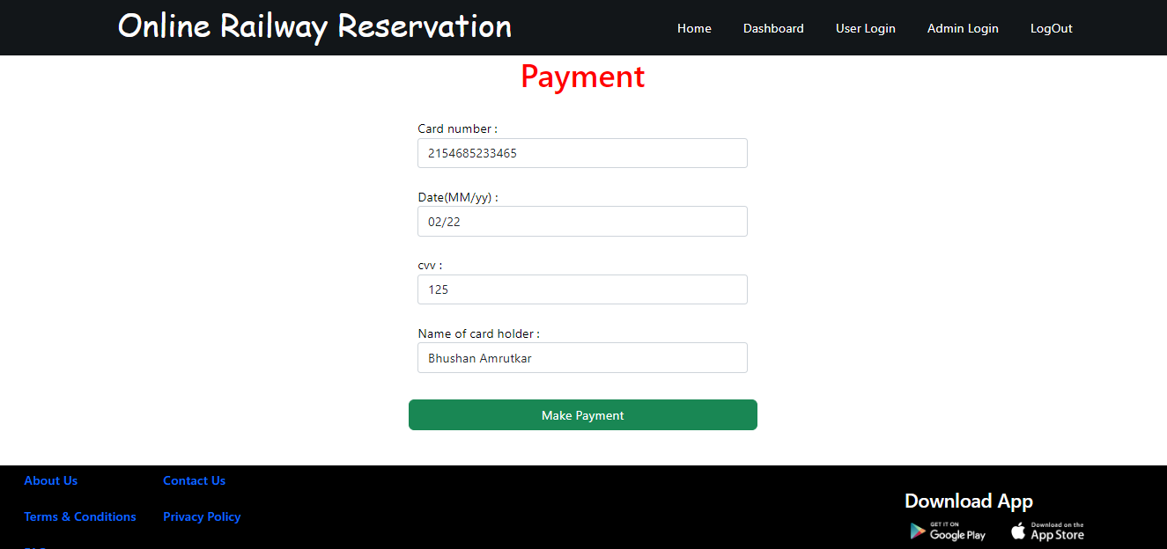
Payment Page :

Slide 28
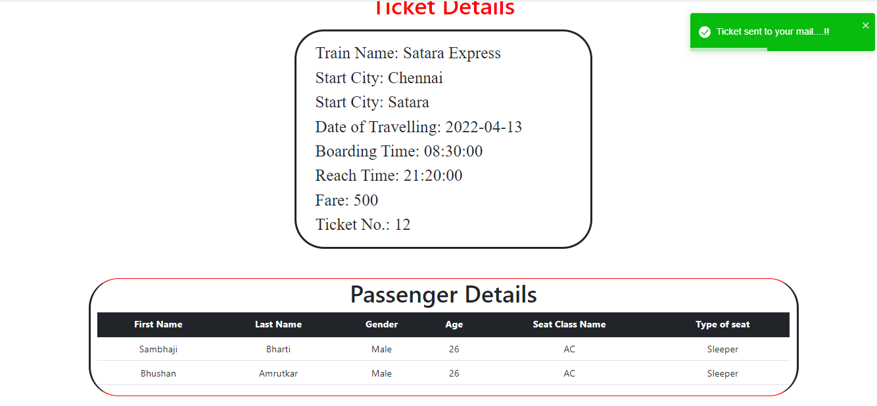
Ticket Generated :

Slide 29
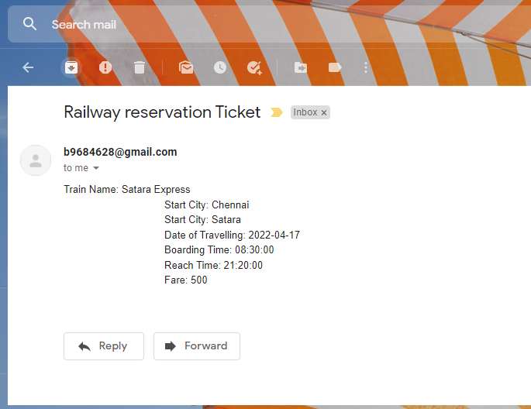
Mail send to User :

Slide 30
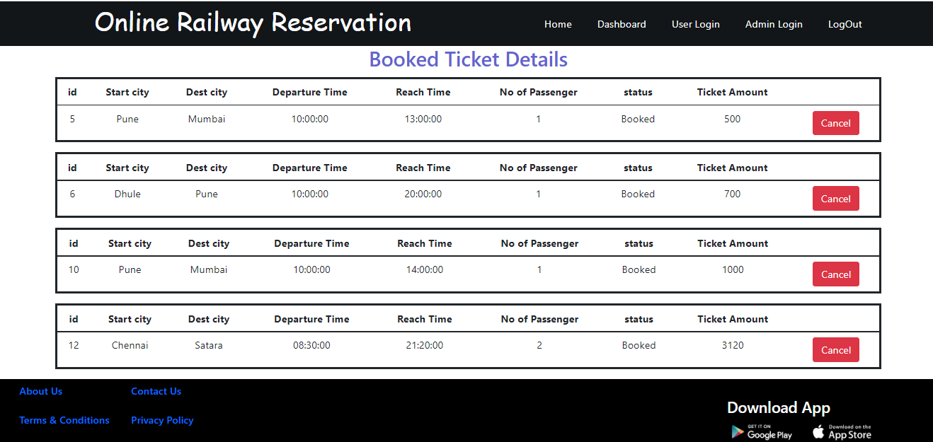
Booked Ticket Page :

Slide 31
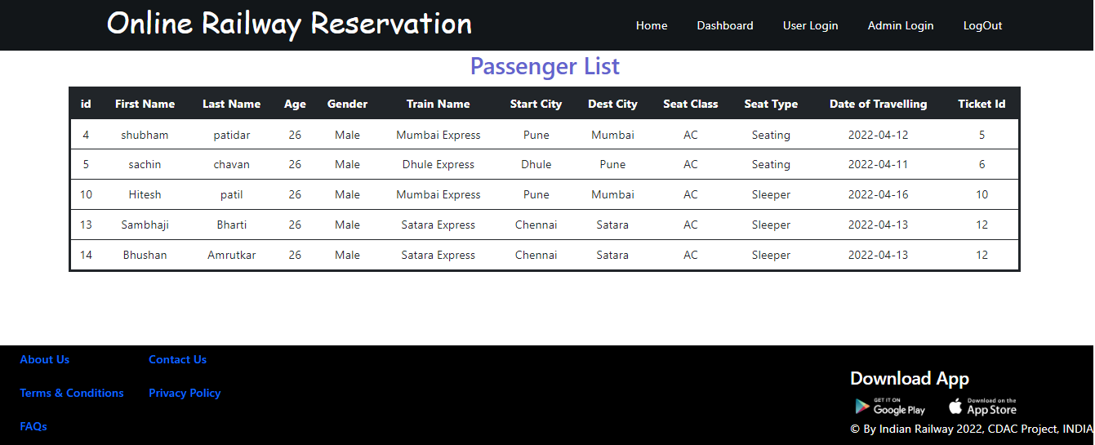
Passenger List Page :

Slide 32
Advantage
Fully online Booking.
Managing customer information.
The online reservation system is very good feature because standing in the queue all the time is just wasting your time.
If we consider case of emergency it will be very helpful
Although there are agent available for book emergency ticket but it could be fraudulent and more expensive than actual price of the ticket.
Passenger Revenue enhancement

Slide 33
FUTURE SCOPE:
The software is flexible enough to be modified and implemented as per future requirements.
We have tried our Best to present this free and user–friendly website to Institutes.
Improved & optimized service

Slide 34
Conclusion
This project aid in automating the existing manual system.
It can be monitored and guarded remotely.
It cut down the man power required and provides accurate information. All the information can be saved and can be accessed at any time.
All the customer, admin can get the required information without delay.
Being able to Book anytime anywhere.

Slide 35
THANK YOU

